Slide 1
2019 MEMBER benefit meeting
METROPOLITAN Alliance of Connected Communities (MACC)
October 30 and November 1, 2018
Ken Amerman – Producer
Claudia P Slovacek – Account Executive
Lori Murphy – Key Account Executive
Danielle Kyllo – Account Representative
© 2017 USI Insurance Services. All rights reserved.

Slide 2
Agenda
MACC / Wells Fargo / USI History
  Group Benefit Buying Power
Current Carrier Overview
Current MACC Benefits Overview
  Dental
  Vision
  Basic Life and AD&D and Voluntary Life
  Short and Long Term Disability
  COBRA and Minnesota Continuation Administration
  Questions

Slide 3
MACC and History with USI and Wells Fargo
Benefit Partners since 2003 with Acordia
Wells Fargo acquired Acordia in 2005
USI acquired Wells Fargo Insurance Services in 2017
Consolidated ancillary lines of coverage under one carrier to obtain lower rates and more competitive benefits
Provide expertise and services not usually available to smaller groups
Provide marketing on a regular basis to determine continued competitiveness of plan designs and rates
More negotiating power with carriers due to larger block of business

Slide 4

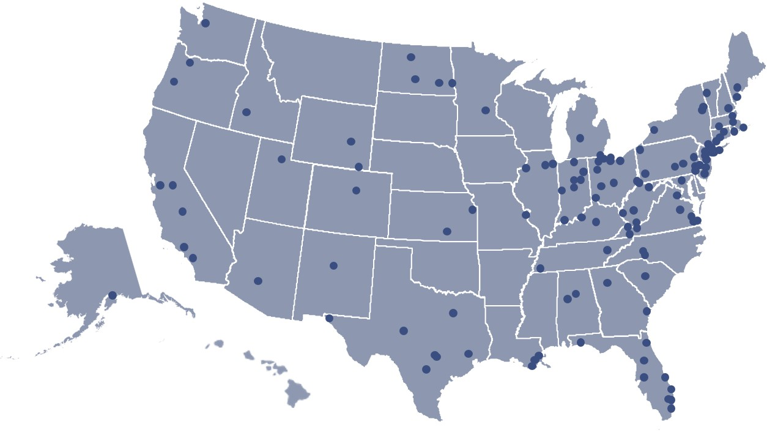
USI Brings National Capabilities & Local Expertise
USI is a national insurance brokerage and consulting firm with more than 150 local offices and 6,000 professionals connected across the U.S. and a leading market position in all core businesses. USI Minneapolis & St. Paul has been serving the local community since 1909.
  Leading National & Local Broker Approaching $2B in Revenue
USI’s North Region
  Over 500 insurance professionals with an average tenure of 15 years and specialists across a broad range of industries
  Dedicated analytics, underwriting, wellness and compliance experts who make up the region’s Technical Resources Team
USI’s Bloomington Office
  Extensive local resources with more than 180 insurance professionals
  Significant market presence in both Employee Benefits and Property & Casualty
Commercial
P&C
Employee
Benefits
Personal
Risk
Retirement
Consulting
© 2014-2017 USI Insurance Services. All rights reserved

Slide 5







USI ONE®, Employee Benefit Solutions
USI’s employee benefit practice is designed to contain cost, promote
regulatory compliance and deliver superior account service.
We focus on seven primary employee benefit service areas.
Underwriting & Analytics
HR
Services
Population
Health
Management
Compliance/ Healthcare Reform
Care Intervention
Pharmacy
Ancillary Benefits
Negotiation & management to contain plan costs
Administration platforms, call centers and service calendars to ease your administrative burdens
Wellness design, disease management analysis and aligned incentives to improve health
Tools, expert guidance, and policies to promote compliance with federal and state regulations
Options for members to make more efficient care decisions without sacrificing quality
Solutions to increase transparency and minimize pharmacy costs
Competitive marketing and scoring drives results for other plan services
A Comprehensive, Holistic View of Your Employee Benefits Plan
© 2014-2018 USI Insurance Services. All rights reserved

Slide 6
Carriers
Dental – Delta Dental of Minnesota
  Largest networks in Minnesota
  Serve 4.1 million members nationwide
Vision – EyeMed/Fidelity Security
  97,000 access points nationwide
  Lenscrafters, Pearle Vision, Target, Sears, America’s Best
Life and Disability – Lincoln Financial Group (LFG)
  Solid financial carrier
  Fortune 250
  Founded 1905
COBRA/MN Continuation – 121 Benefits
  Stress free administration of legally required continuation benefits

Slide 7
Delta Dental Benefit Summary: In Network
 | Delta PPO and Delta Premier
Annual Max Benefit Per Person | $1,250
Deductible | $25 per person $75 family maximum
Diagnostic & Preventive
Cleanings, X-Rays, Exams, Fluoride Treatments, Sealants for children | 100% (Deductible does not apply)
Basic Care
Fillings, Oral Surgery, Periodontics, Root Canals | Deductible, 80%
Major Restorative Care
Crowns, Bridges, Dentures and Repairs | Deductible, 50%
Orthodontics – Dependent Children under age 8 - 18
Orthodontia | 50%
Orthodontic Lifetime Maximum | $1,500
This summary of dental coverage is a general overview of the provisions described in the Membership Contract.

Slide 8
Dental Rate Summary 1/1/19 to 12/31/20
Single | $28.94
Family | $78.82

Slide 9
EyeMed Voluntary Vision Benefit Summary: In Network
Vision Service | Member Cost In-Network
Exam with Dilation | $10 Copay
Frames: | $0 Copay; $130 Allowance, 20% off balance over $130
Standard Plastic Lens
• Single Vision/Bifocal/Trifocal | $25 Copay
Lens Options
• UV Treatment | $15
• Tint (Solid / Gradient) | $15
• Std Plastic Scratch Coating | $15
• Std Polycarbonate - Adult | $40
• Std Polycarbonate - Kids under 19 | $0
• Polarized | 20% off Retail Price
Contact Lenses
• Conventional or Disposable | $0 Copay; $130 allowance, 15% off balance over $130
Frequency
• Examination | Once every 12 months
• Lenses or Contact Lenses | Once every 12 months
• Frames | Once every 24 months

Slide 10
Vision Rate Summary 1/1/19 to 12/31/20
Single | $5.78
Single + Spouse | $10.99
Single + Child | $11.57
Family | $17.00

Slide 11
LFG Basic Life and AD&D Benefit Summary
Benefit Amount | Two Times Annual Earnings
Maximum Benefit | $500,000
Guarantee Issue | $500,000
Reduction Schedule | To 65% at age 70 To 50% at age 75 Terminates at Retirement
Who Pays the Premium? | 100% Employer Paid

Slide 12
Basic Life and AD&D Rate Summary 1/1/19 to 12/31/20
Life per $1,000 | $.085
Accidental Death and Dismemberment per $1,000 | $.018

Slide 13
Voluntary Life Benefit Summary
Benefits:
  Employee – Increments of $10,000 to max of lesser of 5 times annual salary or $500,000
  Spouse – Increments of $5,000 to max of lesser of 50% of employee benefit or $250,000
  Dependent Children
    15 days to 19 years $10,000

Slide 14
LFG Voluntary Life Benefit Summary
Provisions:
  Reduction schedule – to 65% at age 70 and to 50% at age 75
  Accelerated death benefit of up to 75% to a maximum of $250,000
  Waiver of premium
  Conversion
  Portability
  Online will preparation and identity theft protection
  Travel assistance

Slide 15
Voluntary Term Life Benefit Summary
 | Minimum | Guaranteed | Periodic Increase | Maximum
For You | $10,000 | $150,000 | $20,000 | $500,000
For Your Spouse | $5,000 | $30,000 | $10,000 | $250,000
For Your Children | $10,000 | $10,000 | N/A | $10,000
Notes:
This slide shows the minimum, maximum and guaranteed amounts of coverage you can buy for yourself, your spouse and your children. You can choose from [different] [the available] coverage amounts between these minimums and maximums.
If spouse or child coverage: You must buy coverage for yourself before you can buy coverage for your spouse and/or your children. The amount of coverage for either your spouse or your children can’t exceed [100% or 50%] of the amount of coverage you choose.
The guaranteed amount is how much you can buy without answering any medical questions, if you buy coverage before [date]. If you need insurance protection above the guaranteed amount, you can buy additional coverage with proof of good health up to the maximum amount.
Your benefit may be reduced based on your age. Your guaranteed amount or any additional coverage you may be approved for (up to the maximum amount) will be reduced by [XX% at age XX and XX% at age XX].
If you enroll now, you and your dependents will be eligible to increase coverage every year by one $XXXX increment up to the guaranteed amount without answering any medical questions.
If you decide to wait and sign up next year, you will need to provide proof of good health for any coverage you want.
You’ll find details about your life insurance benefit, as well as how much this coverage costs in your enrollment information and benefit summary.

Slide 16
Voluntary Life Rate Summary 1/1/19 to 12/31/20
Age | Employee/Spouse Per $10,000
Less than 30 | $ .80
30-34 | $ .90
35-39 | $1.20
40-44 | $1.80
45-49 | $2.80
50-54 | $4.40
55-59 | $6.70
60-64 | $9.60
65-69 | $16.30
70-74 | $29.10
75+ | $29.10
CHILD RATE $1.00 per $5,000

Slide 17
LFG Short Term Disability Benefit Summary
Elimination Period | 7 days accident 7 days illness
Benefit Percentage | 60%
Maximum Weekly Benefit | $1,500
Definition of Disability | Limited from performing your duties OR loss of 20% of earnings
Maximum period of payment | 12 weeks

Slide 18
Short Term Disability Rate Summary 1/1/9 to 12/31/20
STD per $10 weekly benefit | $.375

Slide 19
LFG Long Term Disability Benefit Summary
Elimination Period | 90 Days
Benefit Percentage | 60%
Maximum Monthly Benefit | $7,500
Conversion | Yes, within 31 days
Social Security Integration | Full Family
Definition of Disability | Loss of 20% of earnings
Pre-existing Condition Exclusion | 3/12
Progressive Income Benefit (Loss of 2 ADLs) | Additional 10% of benefit
Mental/Nervous; Drug/Alcohol | 24 month limitation
Self-reported conditions | 24 month limitation
Employee Assistance Plan | Included, 4 face to face
Survivor Benefit | 3 Months

Slide 20
Long Term Disability Rate Summary 1/1/19 to 12/31/20
LTD per $100 covered payroll | $.25

Slide 21
COBRA/MN Continuation Services
Benefits:
  Initial notices for new hires and newly eligible
  Qualifying event notices for participants
  Compliance on all federal and state statutes
  Services provided by 121Benefits
  No charge to employer

